Slide 1
Hospitality in Brisbane
Preparing for rebuilding post Covid

Slide 2
Rise and Fall
Many hospitality business’ have closed due to the lockdowns imposed due to the corona virus
As the lockdowns end demand will increase providing many new opportunities
Some areas will prove more lucrative than others for investment

Slide 3
Data selection and processing
Region data was collected from files provided by Matthew Proctor
Data on venues was accessed through Foursquare
Remote locations were excluded – only the greater Brisbane area was analysed

Slide 4
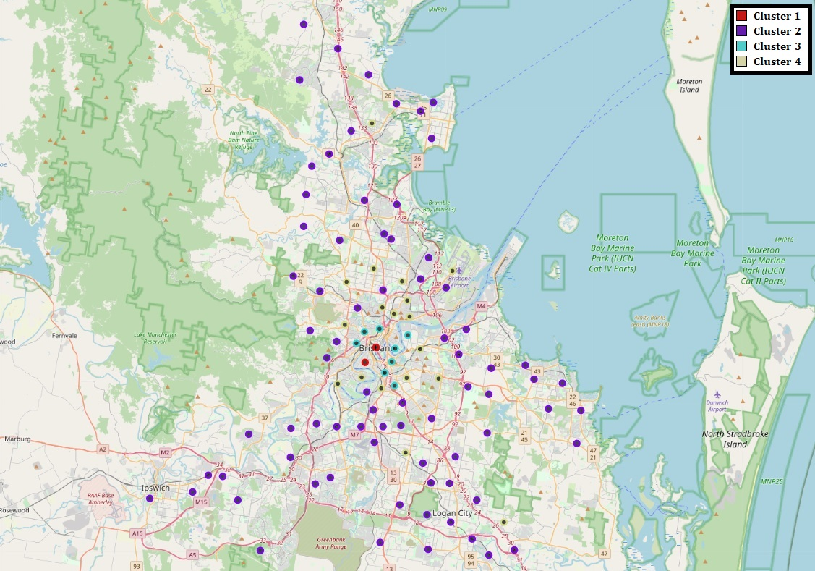
Clustering
K-Means algorithm was used to divide regions into four clusters of different types:
Cluster 1 Inner Urban
Cluster 2 Outer suburb and rural
Cluster 3 Urban
Cluster 4 Inner suburb and satellite town

Slide 5
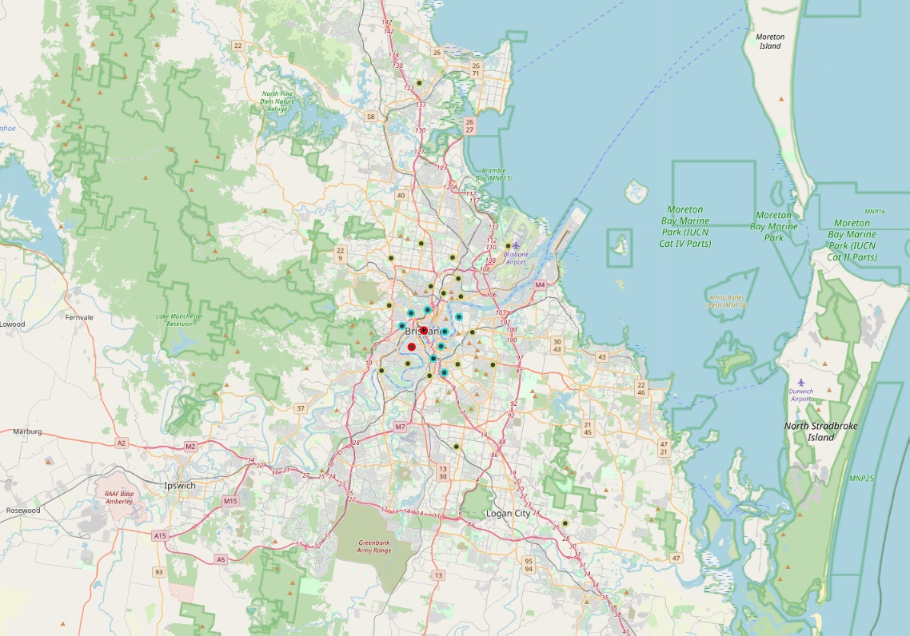
Clustering
Suburban and rural areas were removed as the can only support comparatively limited numbers of venues

Slide 6
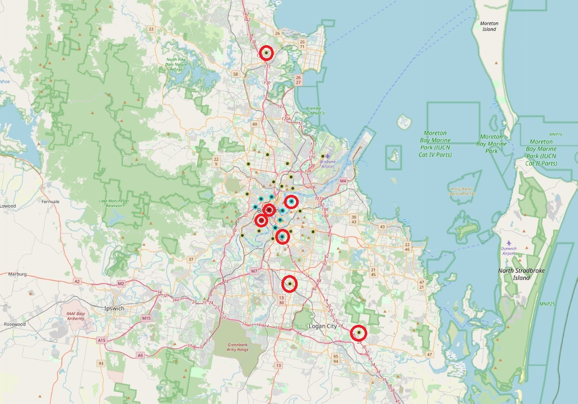
Clustering
Both Inner Urban areas were selected
Two urban areas were included due to separation from the central urban area
Three satellite towns were selected as they provide local hubs for the surrounding regions

Slide 7
Analysis
The 10 most popular venue types were selected for analysis
These venue types are:
Cafes
Fast food restaurants
Pizza parlours
Bars
Pubs
Sandwich shops
Sushi
Bakeries
Thai restaurants
Burger joints

Slide 8
Analysis
Total Venues per Region
Mean Venues per Region for Cluster Type
Post Code | Cafés | Fast Food | Pizza | Bars | Pubs | Subs | Sushi | Bakeries | Thai | Burgers
4000 | 34 | 0 | 1 | 21 | 8 | 0 | 4 | 1 | 5 | 9
4101 | 28 | 0 | 2 | 9 | 7 | 2 | 0 | 1 | 4 | 7
4109 | 3 | 3 | 2 | 0 | 1 | 1 | 3 | 0 | 1 | 1
4120 | 19 | 4 | 1 | 1 | 2 | 2 | 3 | 0 | 2 | 2
4128 | 3 | 6 | 2 | 0 | 1 | 2 | 2 | 0 | 1 | 0
4171 | 15 | 0 | 3 | 1 | 1 | 1 | 2 | 2 | 2 | 2
4509 | 5 | 4 | 2 | 0 | 3 | 2 | 2 | 0 | 0 | 0
Total | 107 | 17 | 13 | 32 | 23 | 10 | 16 | 4 | 15 | 21
Cluster | Cafes | Fast Food | Pizza | Bars | Pubs | Subs | Sushi | Bakeries | Thai | Burgers
1 | 31.000 | 0.000 | 1.500 | 15.000 | 7.500 | 1.000 | 2.000 | 1.000 | 4.500 | 8.000
3 | 18.250 | 1.500 | 2.625 | 4.125 | 3.125 | 2.750 | 2.375 | 2.375 | 2.750 | 3.750
4 | 7.833 | 2.833 | 2.167 | 1.056 | 1.444 | 1.889 | 2.444 | 1.722 | 1.667 | 0.889
All | 12.464 | 2.250 | 2.250 | 2.929 | 2.357 | 2.071 | 2.393 | 1.857 | 2.179 | 2.214
A comparison was made between the number of open venues of each type in a region and the average number available in a region of each cluster

Slide 9
Results
Cluster 1 regions were not considered prime locations for new business’ as they are likely at market saturation and will have higher costs due to the location
The Cluster 3 regions were significantly below average for bars, pubs, and burger joints. In addition, Greenslopes has no bakeries in the area.
The three Cluster 4 regions were short cafes, bakeries and Thai restaurants.

Slide 10
Recommendations
The best opportunity is for a café in North Lakes, Shailer Park or Sunnybank due to the popularity of cafes and a dearth of them open in those ares.
Other good opportunities include:
Burger joints in Bulimba and Greenslopes
A bakery in Greenslopes
Bakeries and Thai restaurants in North Lakes, Shailer Park or Sunnybank

